Slide 1
Machine Learning
Dr. Anil K Ahlawat
Professor, KIET Group of Institutions

Slide 2
Syllabus
B.Tech
M.Tech

Slide 3
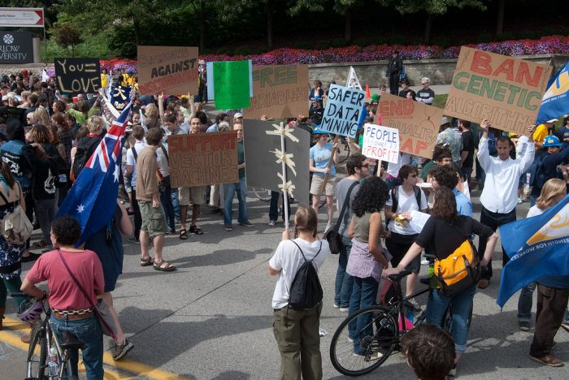
Machine Learning

Slide 4
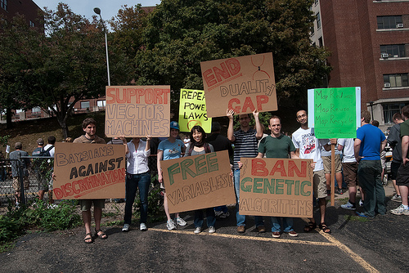
Goals of the course
Be able to laugh at these signs
(or at least know why one might…)

Slide 5
A Few Quotes
“A breakthrough in machine learning would be worth ten Microsofts” (Bill Gates, Chairman, Microsoft)
“Machine learning is the next Internet” (Tony Tether, Director, DARPA)
Machine learning is the hot new thing” (John Hennessy, President, Stanford)”

Slide 6
A Few Quotes
“Web rankings today are mostly a matter of machine learning” (Prabhakar Raghavan, Dir. Research, Yahoo)
“Machine learning is going to result in a real revolution” (Greg Papadopoulos, CTO, Sun)
“Machine learning is today’s discontinuity” (Jerry Yang, CEO, Yahoo)

Slide 7
A little scientific humor
This atom says to his friend, "I'm really upset, I've just lost an electron."
His friend says to him, "Are you sure?"
"Yeah," he replies. "I'm Positive.“
____________________________________________________________________________
How many weeks are there in a light year?

Slide 8
Study strategy:
Review the slides and consult textbook to clarify confusing parts. 3hrs/week
Topics will be assigned to you and you will prepare seminars; 2 period/week
Project topic/articles/research papers will be explored by you and 4hrs/week will be assigned to you and you will work on it. - self

Slide 9
Brain - Storming

Slide 10
Why are you here?
What is Machine Learning?
Why are you taking this course?
What topics would you like to see covered?

Slide 11
Sample Applications
Web search
Computational biology
Finance
E-commerce
Space exploration
Robotics
Information extraction
Social networks
Debugging
[Your favorite area]

Slide 12

Machine Learning is…
Machine learning, a branch of artificial intelligence, concerns the construction and study of systems that can learn from data.

Slide 13
Machine Learning is…
Machine learning is programming computers to optimize a performance criterion using example data or past experience.
-- Ethem Alpaydin
The goal of machine learning is to develop methods that can automatically detect patterns in data, and then to use the uncovered patterns to predict future data or other outcomes of interest.
-- Kevin P. Murphy
The field of pattern recognition is concerned with the automatic discovery of regularities in data through the use of computer algorithms and with the use of these regularities to take actions.
-- Christopher M. Bishop

Slide 14
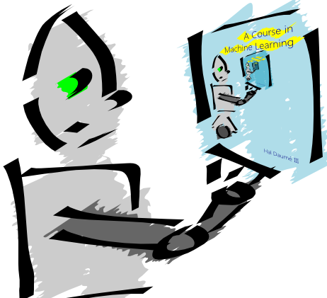
Machine Learning is…
Machine learning is about predicting the future based on the past.
-- Hal Daume III

Slide 15
Machine Learning is…
Machine learning is about predicting the future based on the past.
-- Hal Daume III
past
future
predict
learn
Training
Data
model/
predictor
Testing
Data
model/
predictor

Slide 16
What is machine learning?
A branch of artificial intelligence, concerned with the design and development of algorithms that allow computers to evolve behaviors based on empirical data.
As intelligence requires knowledge, it is necessary for the computers to acquire knowledge.

Slide 17
So What Is Machine Learning?
Automating automation
Getting computers to program themselves
Writing software is the bottleneck
Let the data do the work instead!

Slide 18
ML in a Nutshell
Tens of thousands of machine learning algorithms
Hundreds new every year
Every machine learning algorithm has three components:
Representation
Evaluation
Optimization

Slide 19
Machine learning problems
What high-level machine learning problems have you seen or heard of before
????

Slide 20
Learning system model
Testing
Input Samples
Learning Method
System
Training

Slide 21
Training and testing
Data acquisition
Practical usage
Universal set
(unobserved)
Training set (observed)
Testing set
(unobserved)

Slide 22
Training and testing
Training is the process of making the system able to learn.
No free lunch rule:
Training set and testing set come from the same distribution
Need to make some assumptions or bias

Slide 23
Traditional Programming
Machine Learning
Data
Computer
Output
Program
Data
Computer
Program
Output

Slide 24
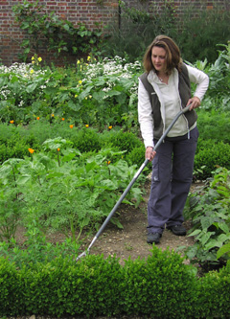
Magic?
No, more like gardening
Seeds = Algorithms
Nutrients = Data
Gardener = You
Plants = Programs

Slide 25
Performance
There are several factors affecting the performance:
Types of training provided
The form and extent of any initial background knowledge
The type of feedback provided
The learning algorithms used
Two important factors:
Modeling
Optimization

Slide 26
Algorithms
The success of machine learning system also depends on the algorithms.
The algorithms control the search to find and build the knowledge structures.
The learning algorithms should extract useful information from training examples.

Slide 27


Algorithms - Types of Learning
Supervised learning ( )
Training data includes desired outputs
Prediction
Classification (discrete labels), Regression (real values)
Unsupervised learning ( )
Training data does not include desired outputs
Clustering
Probability distribution estimation
Finding association (in features)
Dimension reduction

Slide 28
Algorithms - Types of Learning
Semi-supervised learning
Training data includes a few desired outputs
Reinforcement learning
Rewards from sequence of actions
Decision making (robot, chess machine)

Slide 29
Algorithms
Supervised learning
Unsupervised learning
Semi-supervised learning

Slide 30
What ?
Supervised learning
Decision tree induction
Rule induction
Instance-based learning
Bayesian learning
Neural networks
Support vector machines
Model ensembles
Learning theory
Unsupervised learning
Clustering
Dimensionality reduction

Slide 31
ML in Practice
Understanding domain, prior knowledge, and goals
Data integration, selection, cleaning, pre-processing, etc.
Learning models
Interpreting results
Consolidating and deploying discovered knowledge
Loop

Slide 32
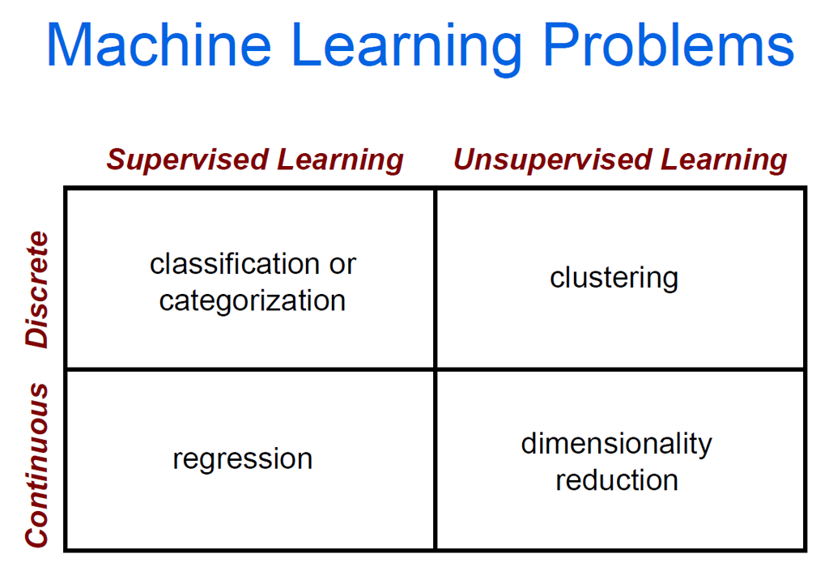

Slide 33

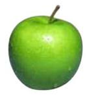
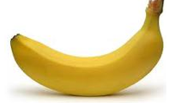
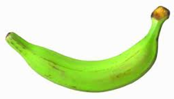
Data
examples
Data

Slide 34

Data
examples
Data

Slide 35

Data
examples
Data

Slide 36



Data
examples
Data

Slide 37
Supervised learning
examples
label
label₁
label₃
labeled examples
label₄
label₅
Supervised learning: given labeled examples

Slide 38
Supervised learning
label
label₁
model/
predictor
label₃
label₄
label₅
Supervised learning: given labeled examples

Slide 39
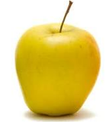
Supervised learning
model/
predictor
predicted label
Supervised learning: learn to predict new example

Slide 40
Supervised learning: classification
label
apple
Classification: a finite set of labels
apple
banana
banana
Supervised learning: given labeled examples

Slide 41
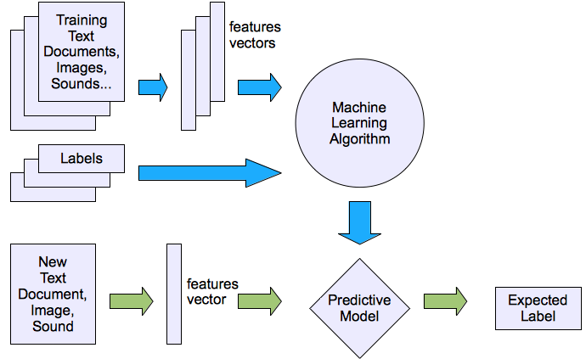
Machine learning structure
Supervised learning

Slide 42
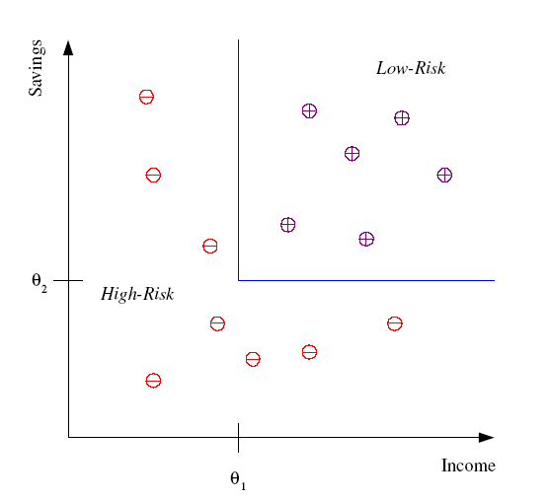
Classification Example
Differentiate between low-risk and high-risk customers from their income and savings

Slide 43
Classification Applications
Face recognition
Character recognition
Spam detection
Medical diagnosis: From symptoms to illnesses
Biometrics: Recognition/authentication using physical and/or behavioral characteristics: Face, iris, signature, etc
...

Slide 44
Classification: Applications
Aka Pattern recognition
Face recognition: Pose, lighting, occlusion (glasses, beard), make-up, hair style
Character recognition: Different handwriting styles.
Speech recognition: Temporal dependency.
Use of a dictionary or the syntax of the language.
Sensor fusion: Combine multiple modalities; eg, visual (lip image) and acoustic for speech
Medical diagnosis: From symptoms to illnesses
Web Advertizing: Predict if a user clicks on an ad on the Internet.

Slide 45








Face Recognition
Training examples of a person
Test images
AT&T Laboratories, Cambridge UK
http://www.uk.research.att.com/facedatabase.html

Slide 47
Supervised learning: regression
label
-4.5
Regression: label is real-valued
10.1
3.2
4.3
Supervised learning: given labeled examples

Slide 48
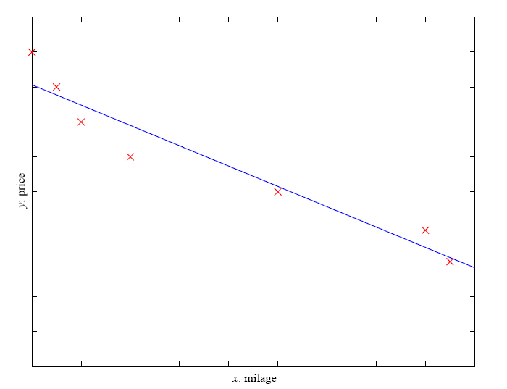
Regression Example
Price of a used car
x : car attributes (e.g. mileage)
y : price
y = wx+w₀

Slide 49
Regression Applications
Economics/Finance: predict the value of a stock
Car/plane navigation: angle of the steering wheel, acceleration, …
Temporal trends: weather over time
…

Slide 50
Supervised learning: ranking
label
1
Ranking: label is a ranking
4
2
3
Supervised learning: given labeled examples

Slide 51
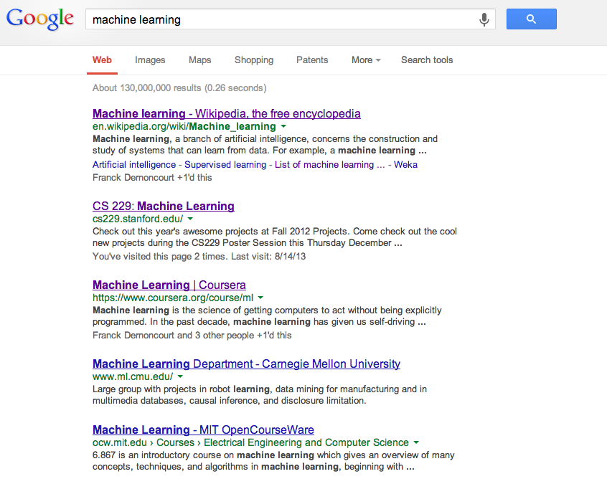
Ranking example
Given a query and
a set of web pages,
rank them according
to relevance

Slide 52



The machine learning framework
Apply a prediction function to a feature representation of the image to get the desired output:
f( ) = “apple”
f( ) = “tomato”
f( ) = “cow”
Slide credit: L. Lazebnik

Slide 53
The machine learning framework
y = f(x)
Training: given a training set of labeled examples {(x₁,y₁), …, (x_{N},y_{N})}, estimate the prediction function f by minimizing the prediction error on the training set
Testing: apply f to a never before seen test example x and output the predicted value y = f(x)
output
prediction function
Image feature
Slide credit: L. Lazebnik

Slide 54
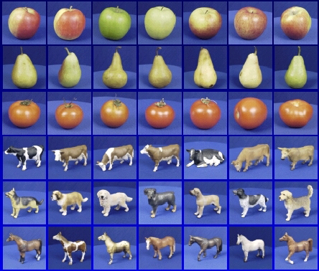

Steps
Training
Training Labels
Training Images
Image Features
Training
Learned model
Testing
Image Features
Learned model
Prediction
Test Image
Slide credit: D. Hoiem and L. Lazebnik

Slide 56
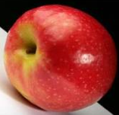
Unsupervised learning
Unupervised learning: given data, i.e. examples, but no labels

Slide 57
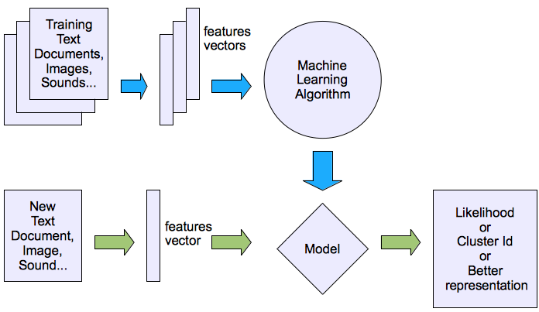
Machine learning structure
Unsupervised learning

Slide 58
Unsupervised learning applications
learn clusters/groups without any label
customer segmentation (i.e. grouping)
image compression
bioinformatics: learn motifs
…

Slide 59
Reinforcement learning
left, right, straight, left, left, left, straight
GOOD
left, straight, straight, left, right, straight, straight
BAD
left, right, straight, left, left, left, straight
18.5
left, straight, straight, left, right, straight, straight
-3
Given a sequence of examples/states and a reward after completing that sequence, learn to predict the action to take in for an individual example/state

Slide 60
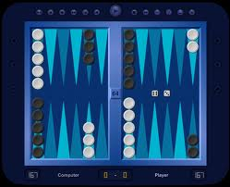
Reinforcement learning example
Backgammon
…
WIN!
…
LOSE!
Given sequences of moves and whether or not the player won at the end, learn to make good moves

Slide 61
Other learning variations
What data is available:
Supervised, unsupervised, reinforcement learning
semi-supervised, active learning, …
How are we getting the data:
online vs. offline learning
Type of model:
generative vs. discriminative
parametric vs. non-parametric

Slide 62
Classifiers: Nearest neighbor
Test example
Training examples from class 2
Training examples from class 1
f(x) = label of the training example nearest to x
All we need is a distance function for our inputs
No training required!
Slide credit: L. Lazebnik

Slide 63
Classifiers: Linear
Find a linear function to separate the classes:
f(x) = sgn(w ⋅ x + b)
Slide credit: L. Lazebnik

Slide 64
Many classifiers to choose from
SVM
Neural networks
Naïve Bayes
Bayesian network
Logistic regression
Decision Trees
K-nearest neighbor
Etc.
Which is the best one?
Slide credit: D. Hoiem

Slide 65
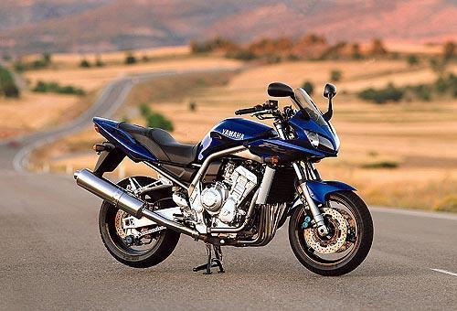
Recognition task and supervision
Images in the training set must be annotated with the “correct answer” that the model is expected to produce
Contains a motorbike
Slide credit: L. Lazebnik

Slide 66
Unsupervised
“Weakly” supervised
Fully supervised
Definition depends on task
Slide credit: L. Lazebnik

Slide 67

Generalization
Training set (labels known)
Test set (labels unknown)
How well does a learned model generalize from the data it was trained on to a new test set?
Slide credit: L. Lazebnik

Slide 68
Generalization
Components of generalization error
Bias: how much the average model over all training sets differ from the true model?
Error due to inaccurate assumptions/simplifications made by the model
Variance: how much models estimated from different training sets differ from each other
Underfitting: model is too “simple” to represent all the relevant class characteristics
High bias and low variance
High training error and high test error
Overfitting: model is too “complex” and fits irrelevant characteristics (noise) in the data
Low bias and high variance
Low training error and high test error
Slide credit: L. Lazebnik

Slide 69
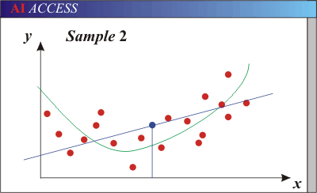
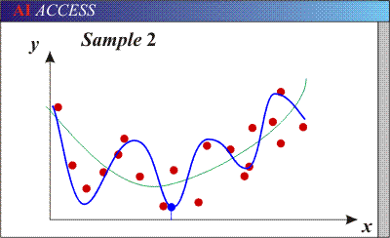
Bias-Variance Trade-off
Models with too few parameters are inaccurate because of a large bias (not enough flexibility).
Models with too many parameters are inaccurate because of a large variance (too much sensitivity to the sample).
Slide credit: D. Hoiem
Notes:
http://www.aiaccess.net/English/Glossaries/GlosMod/e_gm_bias_variance.htm

Slide 70
Bias-Variance Trade-off
E(MSE) = noise² + bias² + variance
Error due to variance of training samples
Unavoidable error
Error due to incorrect assumptions
See the following for explanations of bias-variance (also Bishop’s “Neural Networks” book):
http://www.inf.ed.ac.uk/teaching/courses/mlsc/Notes/Lecture4/BiasVariance.pdf
Slide credit: D. Hoiem
Notes:
From the link above:
You can only get generalization through assumptions.
Thus in order to minimize the MSE, we need to minimize both
the bias and the variance. However, this is not trivial to do this. For instance, just
neglecting the input data and predicting the output somehow (e.g., just a constant), would definitely minimize the variance of our predictions: they would be
always the same, thus the variance would be zero—but the bias of our estimate
(i.e., the amount we are off the real function) would be tremendously large. On
the other hand, the neural network could perfectly interpolate the training data,
i.e., it predict y=t for every data point. This will make the bias term vanish entirely, since the E(y)=f (insert this above into the squared bias term to verify this),
but the variance term will become equal to the variance of the noise, which may
be significant (see also Bishop Chapter 9 and the Geman et al. Paper). In general,
finding an optimal bias-variance tradeoff is hard, but acceptable solutions can be
found, e.g., by means of cross validation or regularization.

Slide 71
Bias-variance tradeoff
Underfitting
Overfitting
Error
Test error
Training error
High Bias
Low Variance
Complexity
Low Bias
High Variance
Slide credit: D. Hoiem

Slide 72
Bias-variance tradeoff
Few training examples
Test Error
Many training examples
High Bias
Low Variance
Complexity
Low Bias
High Variance
Slide credit: D. Hoiem
Notes:
Note: these figures don’t work in pdf

Slide 73
Effect of Training Size
Fixed prediction model
Error
Testing
Generalization Error
Training
Number of Training Examples
Slide credit: D. Hoiem

Slide 74
Remember…
No classifier is inherently better than any other: you need to make assumptions to generalize
Three kinds of error
Inherent: unavoidable
Bias: due to over-simplifications
Variance: due to inability to perfectly estimate parameters from limited data
Slide credit: D. Hoiem
Slide credit: D. Hoiem
Notes:
You can only get generalization through assumptions.

Slide 75
How to reduce variance?
Choose a simpler classifier
Regularize the parameters
Get more training data
Slide credit: D. Hoiem
Notes:
The simpler classifier or regularization could increase bias and lead to more error.

Slide 76
Generative vs. Discriminative Classifiers
Generative Models
Represent both the data and the labels
Often, makes use of conditional independence and priors
Examples
Naïve Bayes classifier
Bayesian network
Models of data may apply to future prediction problems
Discriminative Models
Learn to directly predict the labels from the data
Often, assume a simple boundary (e.g., linear)
Examples
Logistic regression
SVM
Boosted decision trees
Often easier to predict a label from the data than to model the data
Slide credit: D. Hoiem
Notes:
Generative classifiers try to model the data. Discriminative classifiers try to predict the label.

Slide 77
Classification
Assign input vector to one of two or more classes
Any decision rule divides input space into decision regions separated by decision boundaries
Slide credit: L. Lazebnik

Slide 78
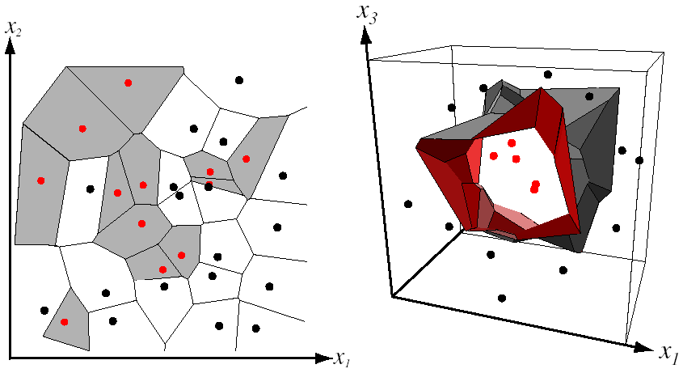
Nearest Neighbor Classifier
Assign label of nearest training data point to each test data point
from Duda et al.
Voronoi partitioning of feature space
for two-category 2D and 3D data
Source: D. Lowe

Slide 79
K-nearest neighbor
x
x
x
o
x
x
x
+
o
o
x
x
o
o
+
o
o
x2
x1

Slide 80
1-nearest neighbor
x
x
x
o
x
x
x
+
o
o
x
x
o
o
+
o
o
x2
x1

Slide 81
3-nearest neighbor
x
x
x
o
x
x
x
+
o
o
x
x
o
o
+
o
o
x2
x1

Slide 82
5-nearest neighbor
x
x
x
o
x
x
x
+
o
o
x
x
o
o
+
o
o
x2
x1

Slide 83
Using K-NN
Simple, a good one to try first
With infinite examples, 1-NN provably has error that is at most twice Bayes optimal error

Slide 84
Two ways to think about classifiers
What is the objective? What are the parameters? How are the parameters learned? How is the learning regularized? How is inference performed?
How is the data modeled? How is similarity defined? What is the shape of the boundary?
Slide credit: D. Hoiem

Slide 85
What to remember about classifiers
No free lunch: machine learning algorithms are tools, not dogmas
Try simple classifiers first
Better to have smart features and simple classifiers than simple features and smart classifiers
Use increasingly powerful classifiers with more training data (bias-variance tradeoff)
Slide credit: D. Hoiem

Slide 86
Some Machine Learning References
General
Tom Mitchell, Machine Learning, McGraw Hill, 1997
Christopher Bishop, Neural Networks for Pattern Recognition, Oxford University Press, 1995
Adaboost
Friedman, Hastie, and Tibshirani, “Additive logistic regression: a statistical view of boosting”, Annals of Statistics, 2000
SVMs
http://www.support-vector.net/icml-tutorial.pdf
Slide credit: D. Hoiem

